Slide 1
Genetic mechanisms of YAA-mediating SLE acceleration

Slide 2
Manuscript Plan
Figure 1. Genetic variations of BXSB
SB strain mutations
BXSB and BXSB_b6y (total spleen)
Cell types
Tlr7
Metabolic process
microRNA (cs)
Yaa locus boundary

Slide 3
? and progress
BXSB is a mosaic of B6 and SB in autosomes

Slide 4
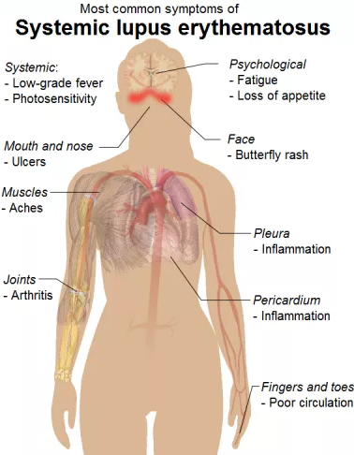
Systemic lupus erythematosus (SLE)
SLE or lupus is a autoimmune disease in which the body’s immune system attacking healthy tissues
Lupus causes inflammation in multiple organs and a wide variety of symptoms
Global prevalence from 20 to 70 per 100,000
It occurs 9 times more often in women than in men
There is no cure
Genetics play a role in susceptibility
Mouse model: male BXSB develops spontaneous lupus-like autoimmune syndrome

Slide 5
Genetic factors of Lupus
Autosomal mutations in BXSB mice contribute to Lupus progression, but what are they?
We approach this question in the transcriptome, and exome levels
RNA-seq from spleens of BXSB and BXSB/B6
Aligned to pooled B6/SB hybrid genome
BXSB
BXSB/B6
Gene
B6 allele
SB allele
B6 allele
SB allele

Slide 6
Align to the B6/SB hybrid genome
Pooled the B6 and SB genes together as a hybrid reference genome, to which we aligned the reads of RNA-seq/WES
Always assign the best match
B6::gene1
SB::gene1
B6::gene1
SB::gene1
B6::gene1
SB::gene1
….
….
….
….
B6::gene1
SB::gene1
Genes have no variation in SB should align to the B6 and SB genes similarly
Genes have variations in SB should align preferentially to either B6 or SB genes than depending on the allele types of that gene in BXSB

Slide 7
What we have detected?
BXSB
BXSB/B6
Gene
B6 allele
SB allele
B6 allele
SB allele
SB and B6 genes preferentially aligned to the SB and B6 alleles, respectively.
YAA genes showed differential RNA levels between BXSB and BXSB/B6 strains

Slide 8
What are the functional consequences?
SB and B6 genes produce different proteins
YAA genes led to different protein amounts

Slide 9
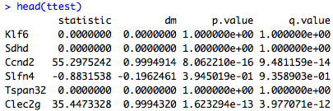
Define the SB genes
Method
Results
“dm” tells proportion of strain-specific alignments; dm = 0.9 means 95% of read for the given genes were aligned strain-specifically

Slide 10
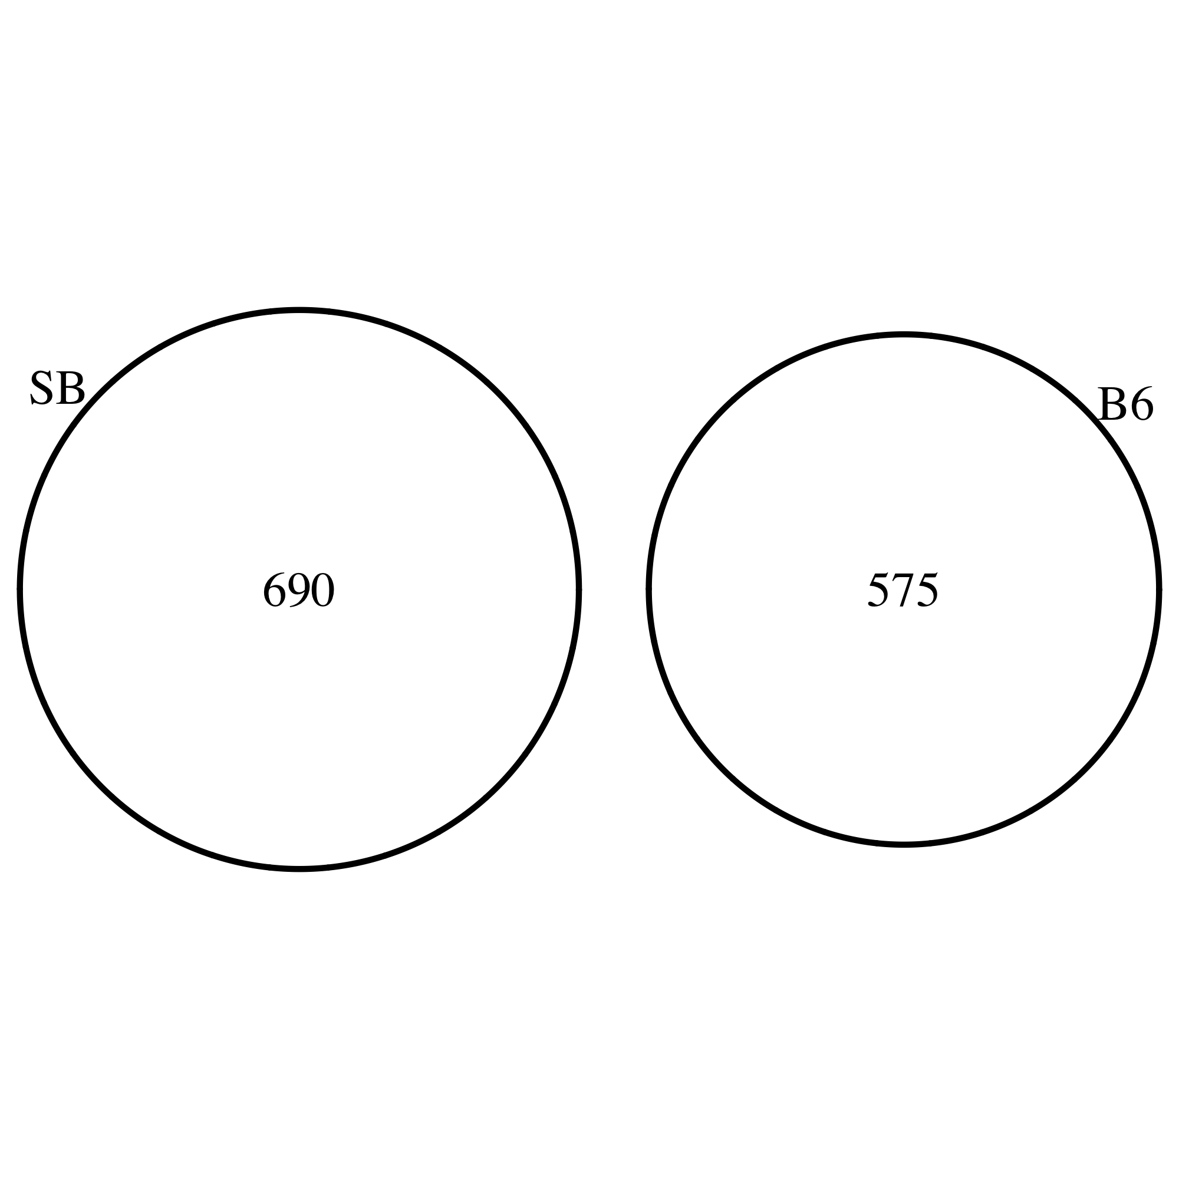
SB genes and B6 genes
SB genes: dm > 0.9, 95% or more reads aligned to the SB allele, q-value 0.05 or less
B6 genes: dm < -0.9, 95% or more reads aligned to the B6 allele, q-value 0.05 or less

Slide 11
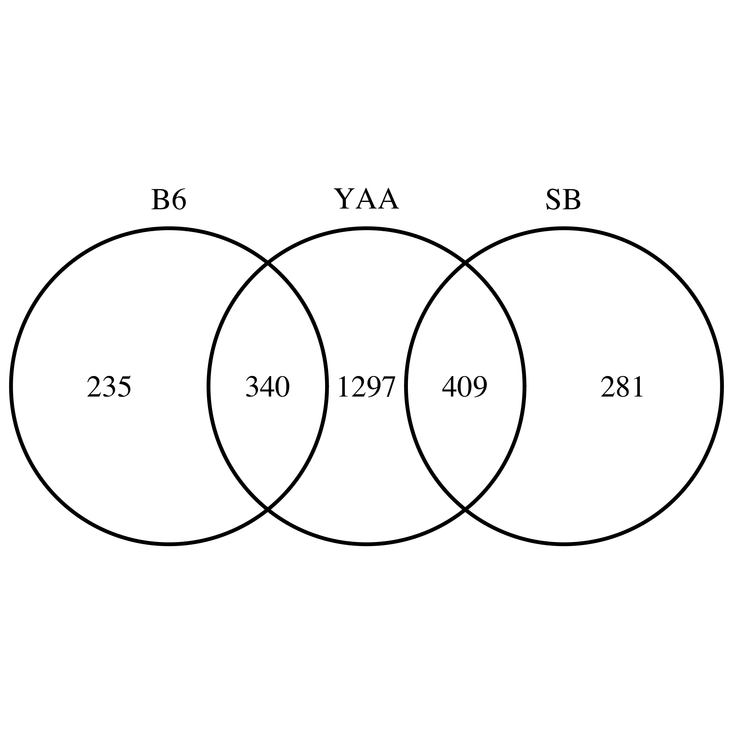
YAA genes
Methods
Merge the B6 and SB alleles for each gene
ttest on log2(tpm) between BXSB and BXSB/B6Y samples (4 and 3)

Slide 12
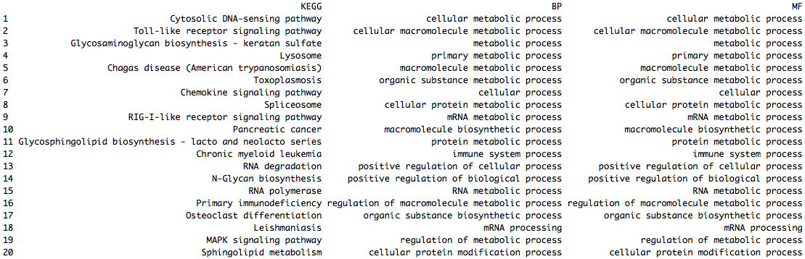
Which gene group matters?
Presumably, SB and B6 genes produced different proteins, while YAA genes led to different amounts of the relevant proteins
409 overlaps between YAA and SB genes: they produced the SB proteins, the protein amounts were further modulated by the extra YAA copy in BXSB Y-chromosome

Slide 13
The potential master regulators

Slide 14
WES of BXSB
Define the SB and B6 genes from WES of BXSB

Slide 15
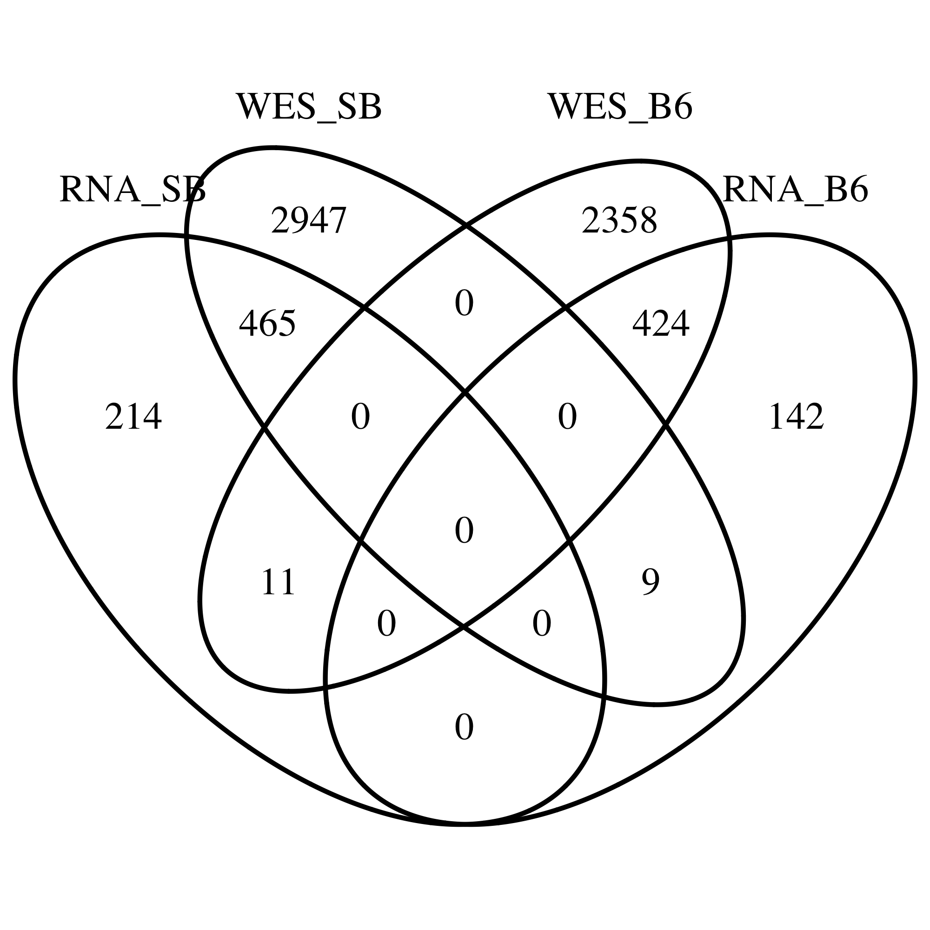
WES of BXSB
Explain the inconsistency between the RNA-seq and WES of BXSB
WES specific genes are likely non-expressed genes
RNA specific genes? (use IGV to visualize the regions)

Slide 16
Introduction of BXSB mouse strain
breakpoint
Chromosome Y (C3H)
YAA (B6)
PAR (B6)
Chromosome X (B6)
YAA (B6)
PAR (B6)
BXSB is an inbred strain by intercrossing progenies of B6 females to SB male
BXSB autosomes are mosaic of B6 and SB, BXSB sex chromosomes are illustrated as above
Yaa mutation in SB: translocation from telomeric end of the X onto the Y chromosome
Yaa locus and BXSB genomic background both relevant to SLE development
Genetic mechanisms are not clear

Slide 17
Yaa context: 10 Mbp telomeric end of X chromosome
PAR
PAR: pseudo-autosome region of chromosome X and Y pair and recombine during meiosis (0.96 and 0.90 Mbp)

Slide 18
Yaa context: 10 Mbp telomeric end of Y chromosome
PAR

Slide 19
Genomic differences of B6 and BXSB

Slide 20
Predict variant’s effect

Slide 21
Which gene has variation? How many?

Slide 22
RNA sequencing on BXSB and BXSB^{B6Y}
BXSB.B6Y by breeding BXSB female with B6 male, so BXSB Y was replaced by B6 Y
Samples: Splenic cells from 10 week old BXSB and BXSB.B6Y (3 and 4, all males)
Pipeline: fastq were trimmed with Trimmomatic, reads were aligned to BXSB pseudo-transcriptome with Bowtie, gene expression levels were estimated with RSEM
Aligning to BXSB pseudo-genome increases alignment rate by approximately 1%
Is the 1% difference in alignment rates causing different estimations on gene expression?

Slide 23
Gene expression levels by aligning to either transcriptome
Aligning to BXSB pseudo-genome increases alignment rate by approximately 1%
Genes that aligned differently?

Slide 24
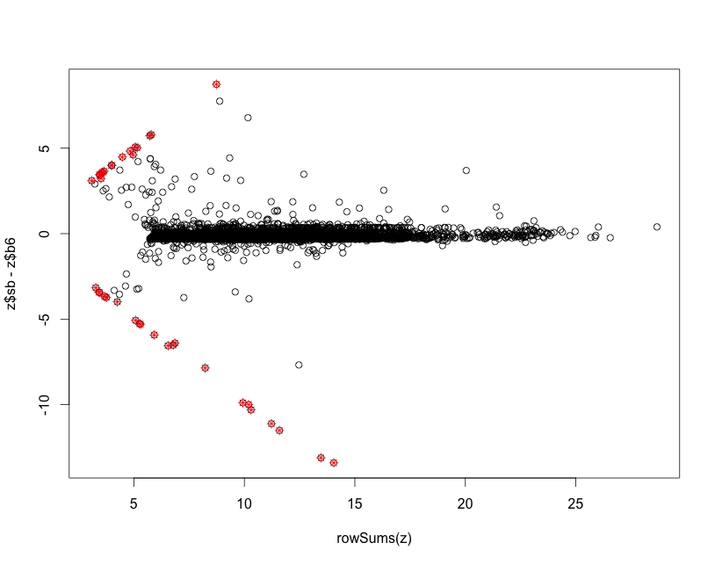
Genes that aligned differently to the B6 and BXSB genomes
X: sum of BXSB and B6 alignments
Y: differences of BXSB and B6 alignments
Minimal TPM 8

Slide 25
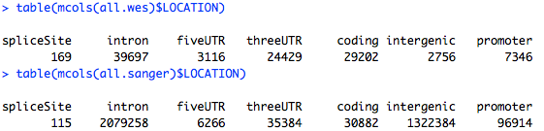
Two sources of BXSB variants: Sanger and JAX/wes
15083 coding variants from JAX/wes, and 16707 coding variants from Sanger
12441 shared coding variants (75% of Sanger and 82% of JAX/wes)

Slide 26
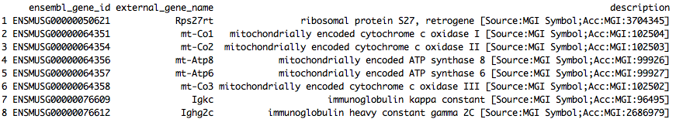
Outlier genes
Igkc and Ighg2c are both annotated for Immunoglobulin (Ig) and T-cell receptor (TcR) Igkc high and twice more in BXSB. Ighg2c higher in BXSB.B6Y. What are they doing?

Slide 27
Outlier genes
I took off the outlier genes and re-normalize the TPM for downstream analysis.

Slide 28
Transcriptional processes in BXSB and BXSB.B6Y splenic cells are very different
q-value < 0.05, log2 fold change > 0.3
1724 out of 9678 are differential
Why the signal so strong?

Slide 29
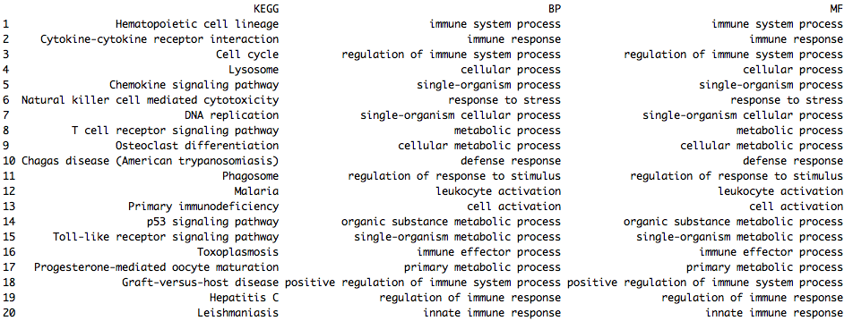
Differential genes are also immunological genes

Slide 30
Materials and Methods
Exome sequencing
BXSB
RNA sequencing
BXSB, BXSB^{B6Y}
Microarray
B6, B6^{YAA}
FASTQ trim
FASTQ trim
Normalization (RMA)
Alignment: Bowtie
Alignment: Bowtie
B6 and BXSB pseudo-genome
DE genes
Variant call
samtools, GATK, VarScan
Expression estimation: RSEM
BXSB pseudo-genome
DE, pathway, Immgen
Microarray: CD3CD4 T-cells
RNA sequencing: Splenic cells from 10 week old BXSB and BXSB.B6Y
BXSB.B6Y males carry the B6 Y chromosome in place of the mutant Yaa-containing Y chromosome of BXSB inbred male mice.

Slide 31
Transcriptional differences between B6 and B6.YAA
p-value < 0.05
977 out of 21755 are differential

Slide 32
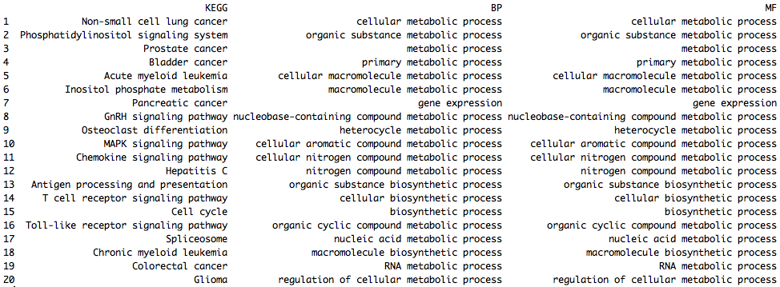
Differential genes are metabolic

Slide 33
Interaction between YAA and genomic backgrounds
DE1: Yaa-targeting genes in the B6 background
B6
Yaa-
B6
Yaa+
DE2: Yaa-targeting genes in the BXSB background
BXSB
Yaa-
BXSB
Yaa+
Intersection between DE1 and DE2 are Yaa-genes irrelevant of genomic background
DE2-specific genes reflect interaction between Yaa locus and BXSB genomic background
DE1-specific genes reflect interaction between Yaa locus and B6 genomic background

Slide 34
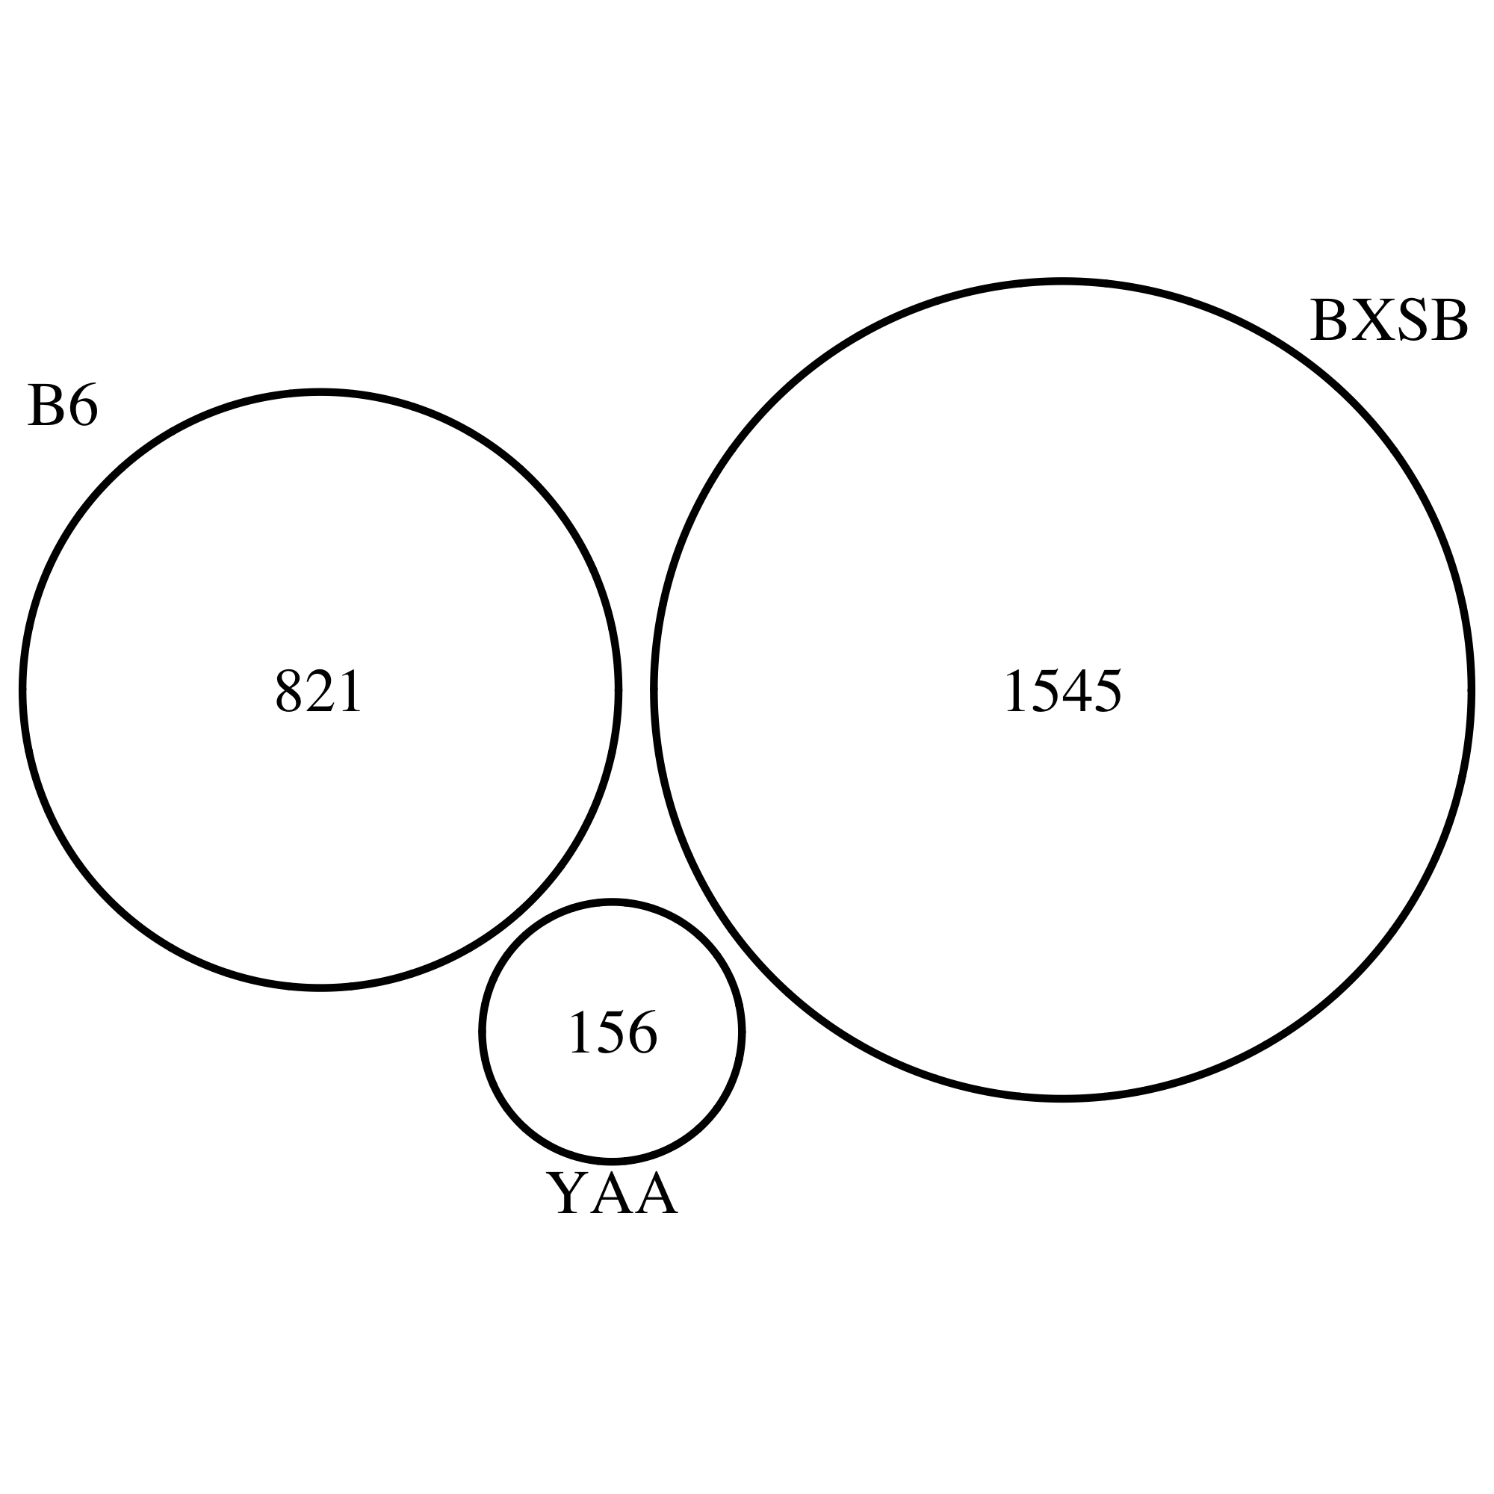
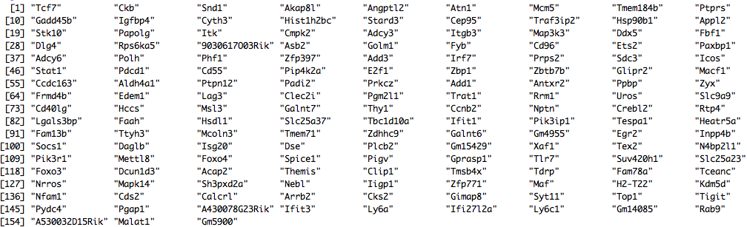
Strong BXSB-specific signal

Slide 35
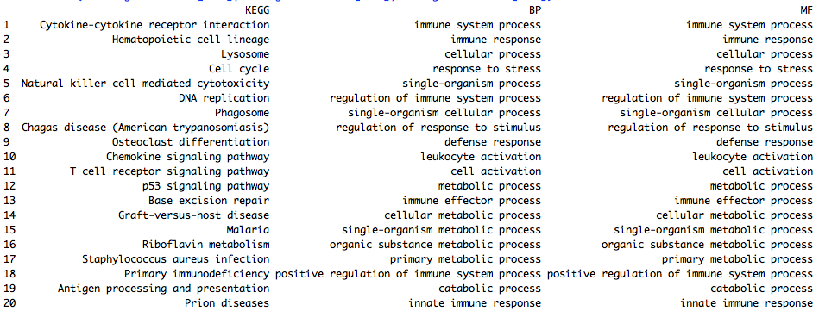
BXSB-specific genes are immunological

Slide 36
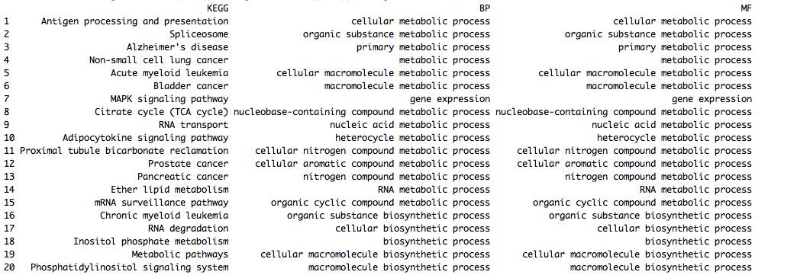
B6-specific genes are metabolic

Slide 37
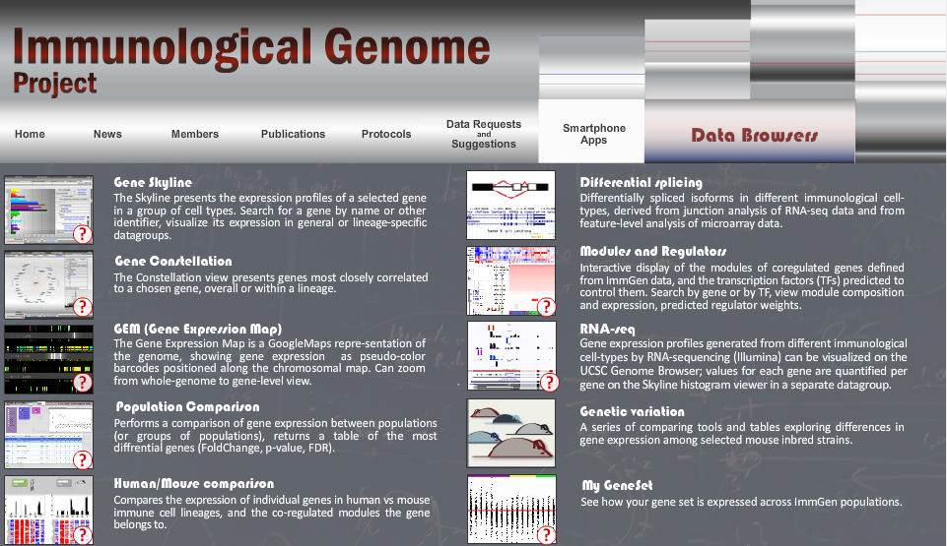
ImmGen modules

Slide 38
BXSB-specific genes in Immgen modules
Top regulators of module 24: Klf9, Tcfec, Ctbp2, Creg1, Tcfe3
Top regulators of module 25: Cebpb, Irf5, Ciita, Atf6

Slide 39
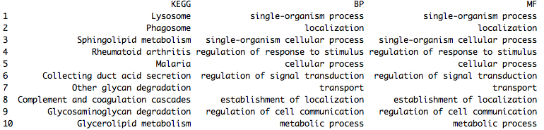
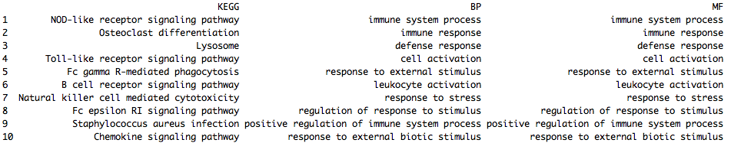
Module 25 is interesting
Module 24
Module 25

Slide 40
Discussion
Biology of ImmGen modules
Map BXSB-specific signal to cell subtypes (ImmGen) and IL21 signaling
BXSB variants-affecting genes

Slide 41
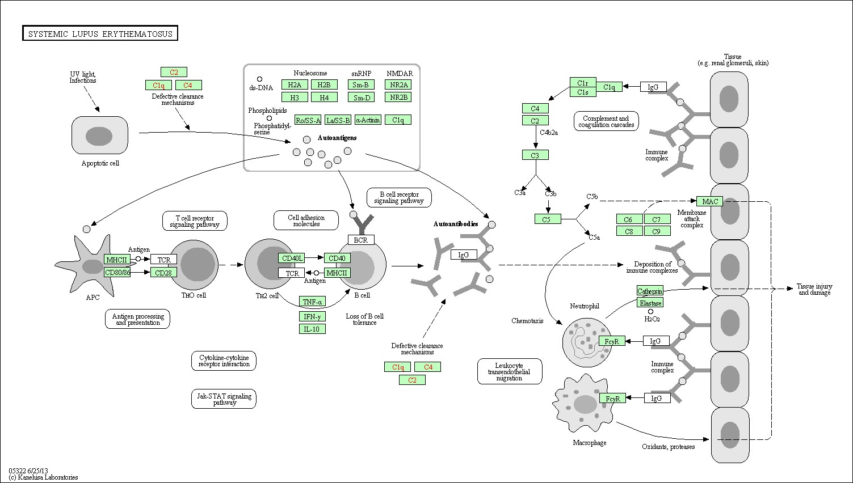
KEGG: SLE

Slide 42
Facts, questions, and approaches
What we know?
YAA mutation was identified to be a translocation from the telomeric end of the X chromosome onto the Y chromosome
YAA locus contains Tlr7 gene, but the exact genomic range is unclear
The accelerated development of SLE in male BXSB mice is associated with the genetically abnormal YAA locus in its Y chromosome
BXSB mice with a B6 Y chromosome do not develop the disease
C57BL/6J mice carrying the YAA gene are indistinguishable from wild type controls
What we have?
B6 and BXSB genome (Steve Munger)
RNA-seq on wild type BXSB and BXSB with B6 Y chromosome
Microarray on wild type B6, and B6 with BXSB Y chromosome
Differential genes, GO, KEGG, and master regulators
What are the questions and how to approach?
What are the genomic differences between BXSB and B6 that are functional?
How to refine the YAA locus?
How to infer a model from the differential genes between BXSB and BXSB^{B6(Y)} in terms of protein cascade?
How the BXSB background cooperate with the extra YAA locus on Y chromosome to accelerate SLE development?
Identify the differential genes between BXSB WT and B6 with BXSB Y chromosome
Integrate the IL21 data or not? How?

Slide 43
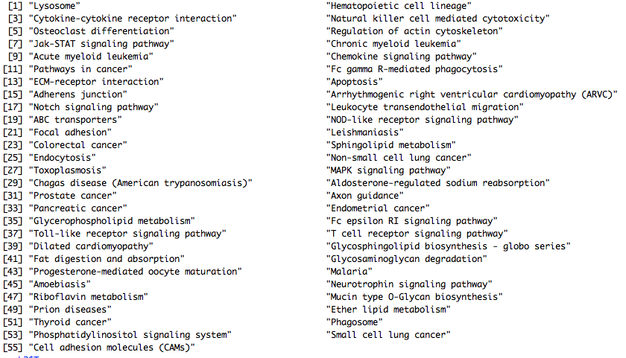
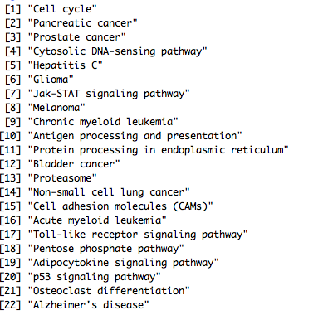
BXSB is the only SLE-causing

Slide 44
IL21 signaling?
 | IL21^{N}ICOS^{N} | IL21^{N}ICOS^{P} | IL21^{P}ICOS^{P}
BXSB^{B6} | 190*** | 100 | 68
BXSB^{YAA} | 43 | 193 | 217***
Fisher’s test: p value equals 2.2e-16
Chi-square test: p values equal 6.613e-12 and 1.52e-13 for BXSB^{B6} and BXSB^{YAA}

